Slide 1

Membership engagement
& Branding

Slide 2
Effective engagement
Our values say a lot
Notes:
Anna

Slide 3
Behavior, attitude, & Values
Choosing to join the EA is a behavior
Behavior is shaped by attitudes
EA’s values change attitudes

Slide 4
Our Values
Fairness
Respect
Dignity
Loyalty
Integrity
Professional
Responsibility

Slide 5
How we Instill our values
New Employee Orientations
New Member Orientations
One-on-ones
Branding

Slide 6
How to talk about the EA
Words have power
Notes:
Chris L section

Slide 7
Question
What is the EA?
Notes:
It is not an outside third party, service, or insurance!
We don’t represent, we advocate! We, the employees, are the union, we represent ourselves
Employees simply want to feel productive and useful at work, receive praise from their employer when they perform their duties well, feel respected by their employer, and have time for their family and other activities outside of work.

Slide 8
Defining values
Colleagues working together
Personal responsibility
Collaborate with management to resolve challenges
Pooling limited resources
More efficient and effective way to advocate
Holding folks accountable
Maintain professionalism in the workplace
Encouraging merit over favoritism and nepotism

Slide 9
Potential Members
Non-members should be viewed as potential members, even those who hold anti-union views.
  The more respectful and positive we are, the less those who disagree hold against us.
  Maybe they won't join today, but something might happen in the future that makes them change their mind.
    Do not let your feelings, political views or ego get in the way of this process.

Slide 10
The “me” Factor
Potential members need to see value in how membership will benefit them
Here are some points to focus on:
  Our ability to promote improvements and fairness, as well as collaborate with managers over changes that impact your work, is influenced by our colleagues willing to join.
  The more who are willing to join with their colleagues over their careers, the more influence and standing the EA has within the TVA and policy makers.

Slide 11
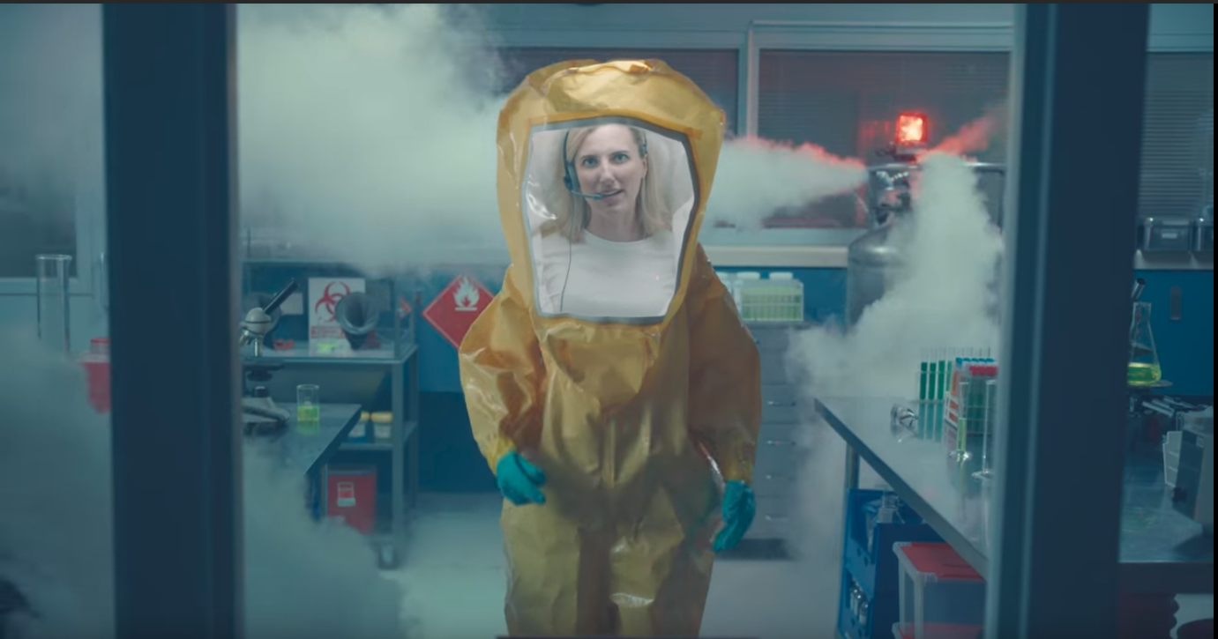
Typical Pro Union messaging

Slide 12
Stop with the Gratitude
Individuals will not join based on gratitude alone
  Example - “Labor brought you the weekend”
    What this statement implies and why it is meaningless: join us to show us your gratitude for something that happened in the past and that is a given today
Gratitude is something you earn, not a sound bite you use for recruitment and communication
Notes:
Everyone local will lose bargaining power through attrition

Slide 13

Pro Union messaging

Slide 14


Debating does not work
Why?
Notes:
We, the employees, working together through our EA, is the only entity advocating for our career and livelihood. We cannot count on politicians or managements to fix things for us if we are not willing to do it ourselves.

Slide 15
Recruitment Drive
An overview
Notes:
Paul T

Slide 16
An overview
Set goals
Prep materials and applications
Review your talking points
Assign members to engage potential members
Recruit
Assess results
Set date for next engagement

Slide 17
Be Prepared
Applications/paperwork
List of potential members
Handouts/brochures
Website (contact/public face)
Communications (what is the union doing)

Slide 18
One-on-Ones
Key to success
Notes:
Anna

Slide 19
Engaging potential members
Part I
Have an intro
Do not over sell
Resonate with potential members
Incorporate “hot” issues
Talk about successes
Make sure your points appeal to self interest
Take into consideration their career and values
Discuss why joining the union made sense for you

Slide 20
Engaging potential members
Part II
What to Focus on During Your Conversations
  Stay positive
  Explain how the EA is relevant to them
  Why you need their support to be successful
  Validate their concerns & issues (you do not need to agree)

Slide 21
Engaging potential members
Part III
What to Avoid During Your Conversations
  No grievances and arbitration talk
  No partisan politics
  No labor history (stop with the gratitude)
  No “what the has the EA done for you lately” speeches
  No outside economic factors (too abstract)
  Do not engage in a debate

Slide 22
Engaging potential members
Part IV
Final Tips
  Listen, Do Not Lecture
  Always Have an “Ask”!
  Approach new/probationary employees
Other ideas and tips?

Slide 23
Tag-team Recruitment
An advance Strategy
Notes:
David S

Slide 24
Tag-Team Overview
Part I
1st Attempt
Recruitment Volunteer A
Jan 10th: Potential member was open to learning more about their union, but was not ready to sign up
2nd Attempt
Recruitment Volunteer B
Jan 19th: Potential member asked questions about dues and benefits, but wanted more time before signing
3rd Attempt
Recruitment Volunteer C
Feb 5th: Potential member signed up to become a member after a short discussion
Example
Potential Member

Slide 25
Tag-Team Engagement
Part II
An Example
  Assign your engagement committee people to engage
  Start the recruitment campaign
  After 2-3 weeks, meet up and report out
  Assign your committee to people to engage - 2nd round
  After 2-3 weeks, meet up and report out
  Assign your committee to people to engage – 3rd round
  After 2-3 weeks, meet up and assess the overall results
Is this right for you?

Slide 26
Next steps
Let create a plan of action

Slide 27
Questions to ask yourselves
Who should we get to help to recruit potential members?
How many potential members can we engage?
When will we start?
Who will follow up with each volunteer to check in?
When do we want to meet to review our efforts?

Slide 28
BRANDING
Stop living in the shadows

Slide 29







What is a brand
Your “brand” is what others think of you and/or your organization

Slide 30
Effective branding
Logo integration
Messaging
Slogan/tagline
Swag/marketing materials
Communication

Slide 31
Communications
Explain your values & pushing your brand

Slide 32
Why is COMMS important
Clarify your goals and objectives
Identify and remind who are the stakeholders
Ensure everyone is on the same page
Become the source of solid information
Help members feel valued
Keep members active
Avoid out of sight, out of mind
Minimize confusion
Recruit potential members

Slide 33
Types of communication
Interactive
  Meetings
  One-on-ones
  Surveys (Google Forms – free)
Active/Push
  Emails
  Print
  Social media
  Phone Texts
Passive/Pull
  Website
  Posters/bulletin boards

Slide 34
When to communicate
One-on-ones
  Recruitment drives and check-ins to show members you care
Regularly planned communication
  Quarterly or Biannual newsletter (print and/or PDFs)
Ad-hoc Communication
  Email and/or text of important news and updates
Meetings

Slide 35
What To include
Challenges the EA is facing and how members (or joining) can help
Upcoming events
General updates on negotiations
General workplace news and challenges
Celebrations and positive news
EA’s values
How to join
Notes:
It is not an outside third party, service, or insurance!
We don’t represent, we advocate! We, the employees, are the union, we represent ourselves
Employees simply want to feel productive and useful at work, receive praise from their employer when they perform their duties well, feel respected by their employer, and have time for their family and other activities outside of work.

Slide 36
What to avoid
Third party talk (e.g., the union will...)
Threats
Grievances, especially ones that are personal in nature
Politics
Going negative without a solution or fix
Putting management in a corner
Spreading rumors
Not explaining what the Local is doing
Stating an issue without a plan or goal for the Local
Notes:
It is not an outside third party, service, or insurance!
We don’t represent, we advocate! We, the employees, are the union, we represent ourselves
Employees simply want to feel productive and useful at work, receive praise from their employer when they perform their duties well, feel respected by their employer, and have time for their family and other activities outside of work.

Slide 37

Handouts, literature…USE YOUR MEMBERS!!

Slide 38
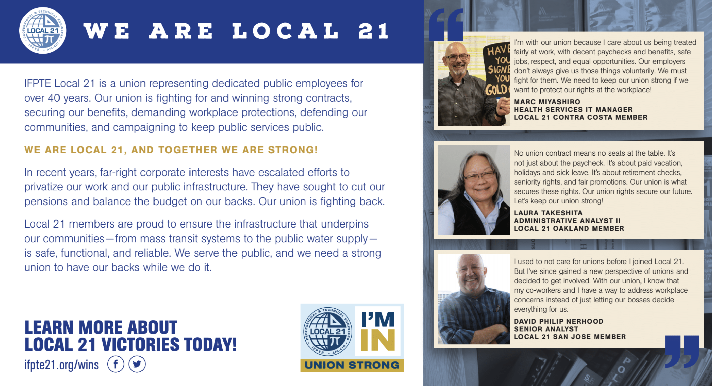

Slide 39
Newsletter
It’s easier than you think

Slide 40
Newsletter basics
Title/Heading
  Who are you
  Why you should read (the hook)
Body
  Summary of the issues
  Clear and to the point
Contact/Follow Up
  Where to learn more
  Contact information
  List of officers and stewards/reps
  How to join as a member
We can provide a Word file template to help!

Slide 41

IFPTE Local 9 Example

Slide 42
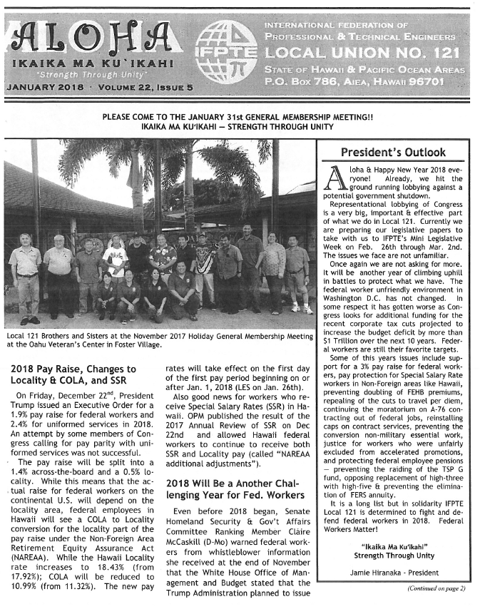
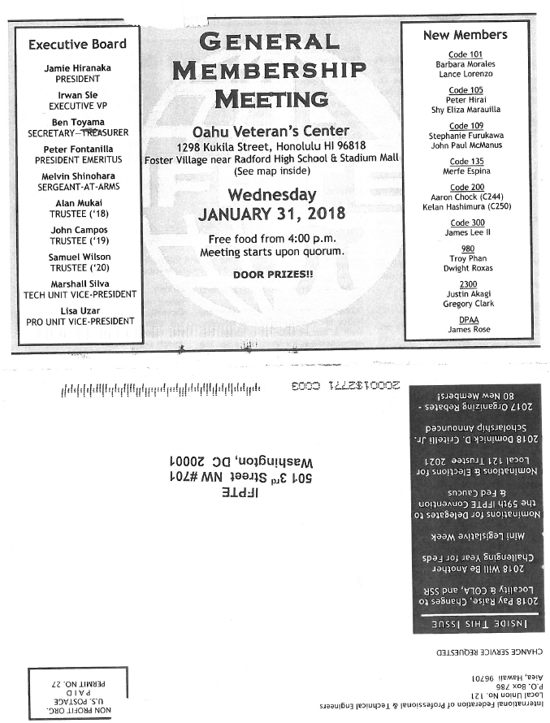
IFPTE Local 121 Example

Slide 43
10% increase in EA’s Membership
Goals help
Notes:
Anna

Slide 44
Ten percent Increase
We want to increase membership by 10% each year
Provides us a path forward, while keeping it realistic and manageable

Slide 45
It Is Time to recruit
What are you waiting for?

